Slide 1


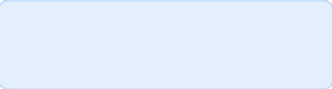
Medical Chatbot: Intelligent Question Answering with BioBERT and OpenVINO
Author:L.Roken kumar singha
Date:04/05/2025

Slide 2

CONTENTS
1. Introduction
2. Problem Statement
3. Project Objectives
4. System Architecture
5. Dataset
6. Model Training
7. Model Optimization
8. Implementation
9. Challenges Faced
10. Results
11. Conclusion
12. References

Slide 3
1. Introduction

Slide 4

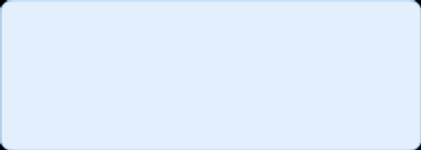
Project Overview
"A medical chatbot designed to answer healthcare-related questions using natural language processing (NLP)."
"Built with a fine-tuned BioBERT model, optimized with OpenVINO, and deployed via Flask."
"Originally used a CSV dataset, now updated to use a JSON file for question-context pairs."

Slide 5
2. Problem Statement

Slide 6


Why This Project?
1
"Patients and professionals need quick, accurate answers to medical queries."
2
"Challenge: Processing complex medical questions efficiently and accurately."
3
"Goal: Provide a scalable, optimized solution using AI."

Slide 7
3. Project Objectives

Slide 8





Objectives
"Develop a chatbot to answer medical questions from a predefined JSON dataset."
"Fine-tune BioBERT for question-answering tasks in the medical domain."
"Optimize inference speed using OpenVINO."
"Deploy as a web application with Flask."

Slide 9
4. System Architecture

Slide 10

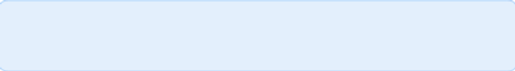
Architecture
Diagram showing:
Input: User question via Flask endpoint (/generate).
Data: JSON file (questions.json) with question and context.
Processing: Fine-tuned BioBERT → ONNX → OpenVINO IR → Inference.
Output: Extracted answer returned as CSV response.
Key components: Flask, BioBERT, OpenVINO, CSV.

Slide 11
5. Dataset

Slide 12
Data Source
1
"Original: processed_data.csv with questions, context, answers (2542 entries)."
2
"Updated: processed_data.csv with question and context pairs."
3
"Example Entry: {'question': 'What are the symptoms of a cold?', 'context': 'Common cold symptoms include a runny nose, sneezing, sore throat, and mild fever.'}"
4
"Focus: Medical domain questions."

Slide 13
6. Model Training

Slide 14





Training BioBERT
"Base Model: dmis-lab/biobert-base-cased-v1.1."
"Fine-Tuning: Used train.py with Hugging Face Trainer on JSON data."
"Parameters: 3 epochs, batch size 4, max_length 512."
"Output: Saved to F:/medical_chatbot/models/fine_tuned_biobert."

Slide 15
7. Model Optimization

Slide 16
Optimization with OpenVINO
"Conversion: PyTorch → ONNX → OpenVINO IR (biobert_finetuned.xml, .bin)."
"Script: optimize.py exports and converts the model."
"Benefit: Faster inference on CPU, reduced latency."

Slide 17
8. Implementation

Slide 18
Chatbot Implementation
"Framework: Flask web app (app.py)."
"Endpoint: /generate accepts POST requests with CSV ({'question': '...'})."
"Logic: Matches question to CSV, runs OpenVINO inference, returns answer."

Slide 19
9. Challenges Faced

Slide 20
Challenges and Solutions
"Challenge: 'OpenVINO returned an empty response' due to untrained model."
Solution: Fine-tuned BioBERT and fixed tokenizer (BertTokenizerFast).
"Challenge: Paging file error (OSError 1455)."
Solution: Increased virtual memory in Windows.

Slide 21
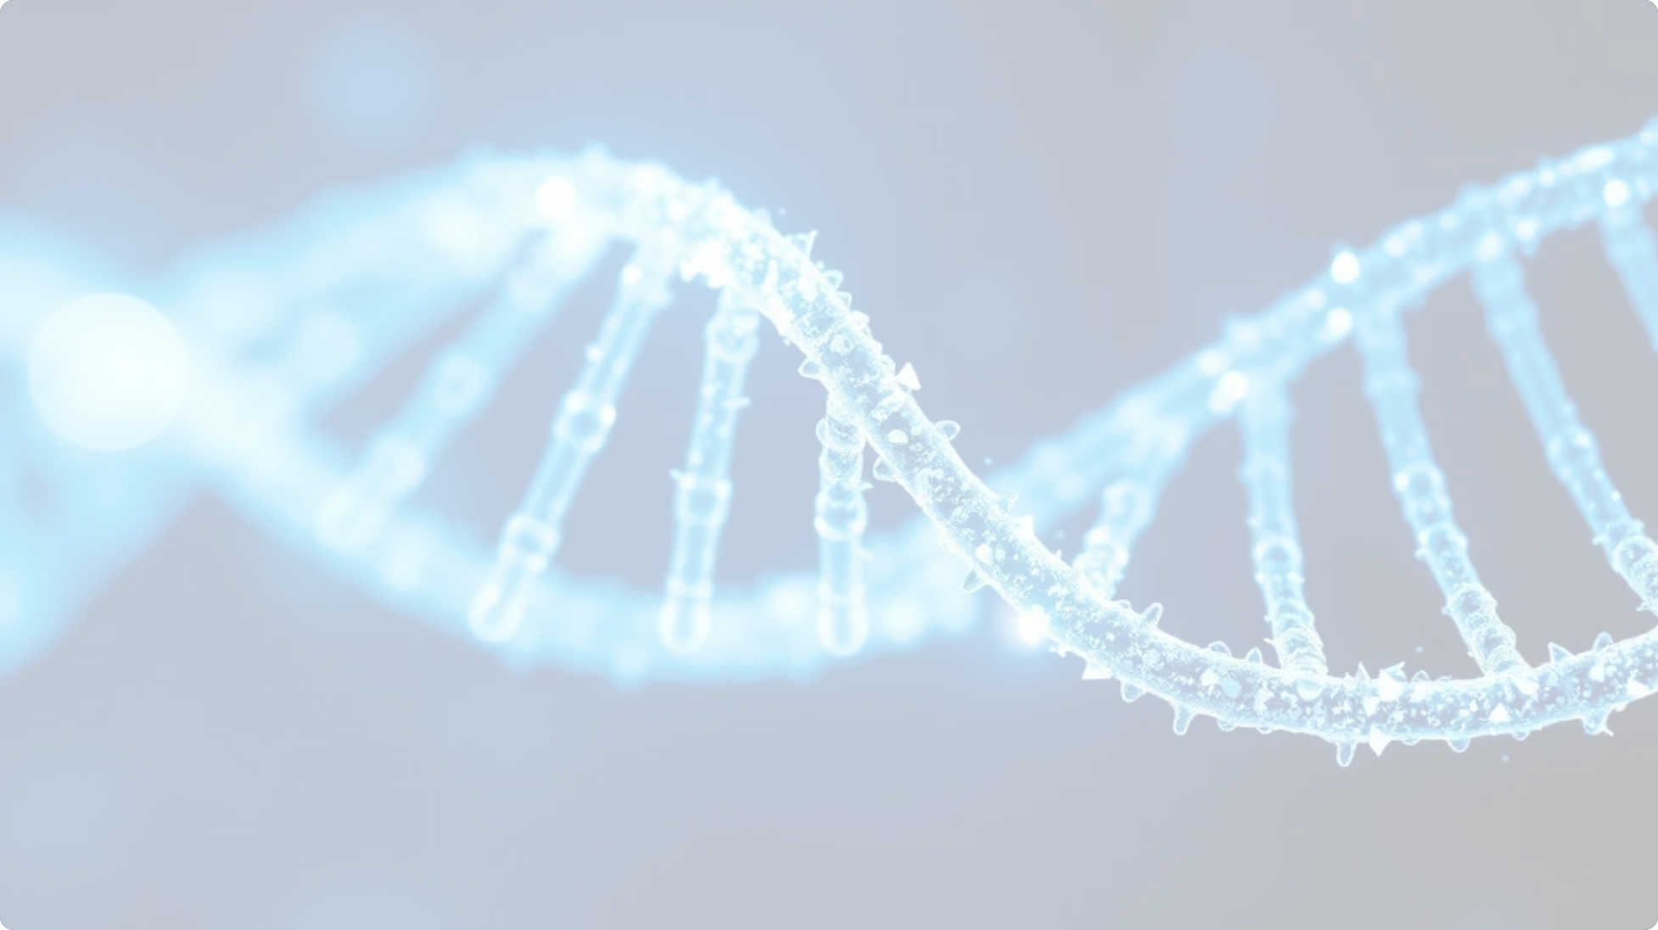
Challenges and Solutions
Challenge | Solution
'OpenVINO returned an empty response' due to untrained model | Fine-tuned BioBERT and fixed tokenizer (BertTokenizerFast)
Paging file error (OSError 1455) | Increased virtual memory in Windows

Slide 22
10. Results

Slide 23



Results and Demo
"Input: 'What are the symptoms of a cold?'"
"Output: 'runny nose, sneezing, sore throat, and mild fever' (if in CSV)."
"Performance: Accurate for CSV questions, fallback for unmatched queries."

Slide 24
11. Conclusion

Slide 25



Conclusion
"Successfully built a medical chatbot using BioBERT and OpenVINO."
"Optimized for speed and deployed as a Flask app."
"Ready for real-world medical query assistance with further enhancements."

Slide 26
12. References

Slide 27
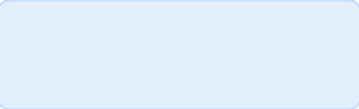
References
"Hugging Face Transformers: https://huggingface.co/docs/transformers"
"OpenVINO Documentation: https://docs.openvino.ai"
"Flask: https://flask.palletsprojects.com"
"BioBERT: Lee et al., 2019"

Slide 28
Thank You

